Slide 1




PirateShip: Append-Only Ledger with (Mostly) Trusted Execution Environments
Shubham Mishra <shubham_mishra@berkeley.edu>
Chawinphat Tankuranand
Natacha Crooks
Heidi Howard
Markus Kuppe*
* Work done while at Microsoft

Slide 2

Distributed Trust
Deposit
(A, 5)
Deposit
(B, 10)
Transfer
(A, B, 3)
Transfer
(B, A, 6)

Slide 3
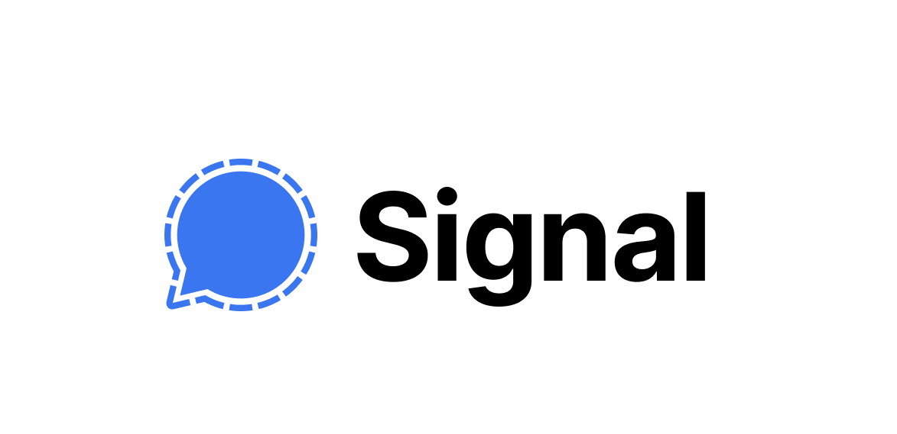
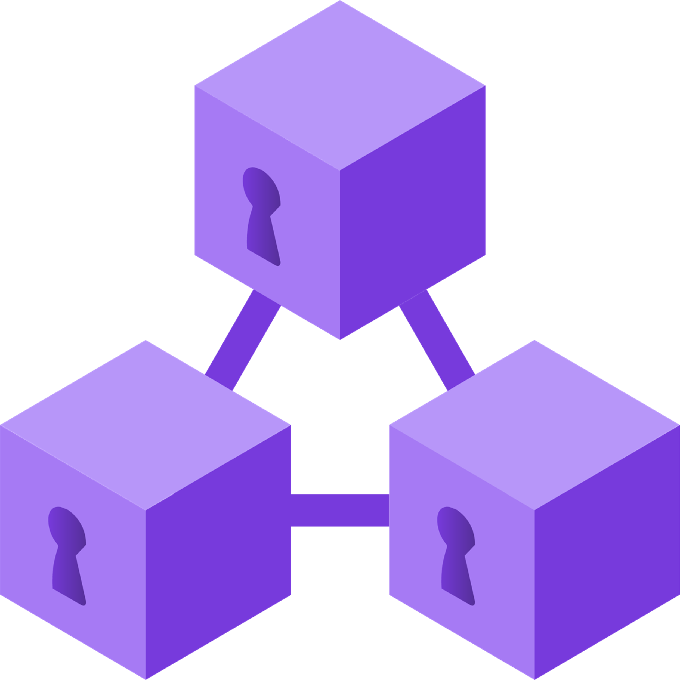
Distributed Trust
Azure Confidential Ledger

Slide 4

System Assumptions
Minority Compromises

Slide 5
System Assumptions
Minority Compromises
Independent Failures

Slide 6



TEEs raise the barrier for attacks
Integrity protection ⇒
Minority Compromises
Almost no
^
Confidentiality ⇒
Independent Failures

Slide 7
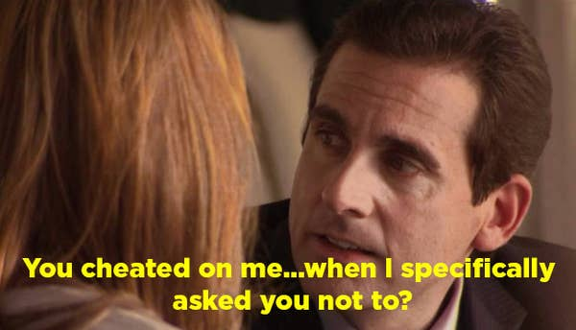
But…
Do TEEs remain secure forever?
leaked my credentials

Slide 8
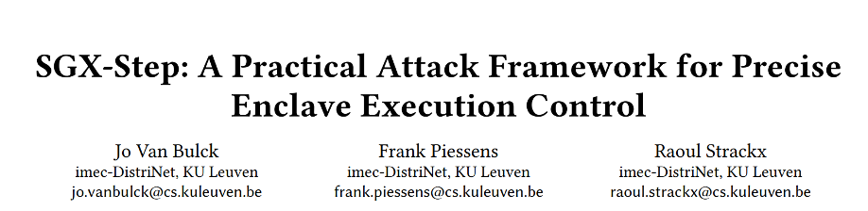
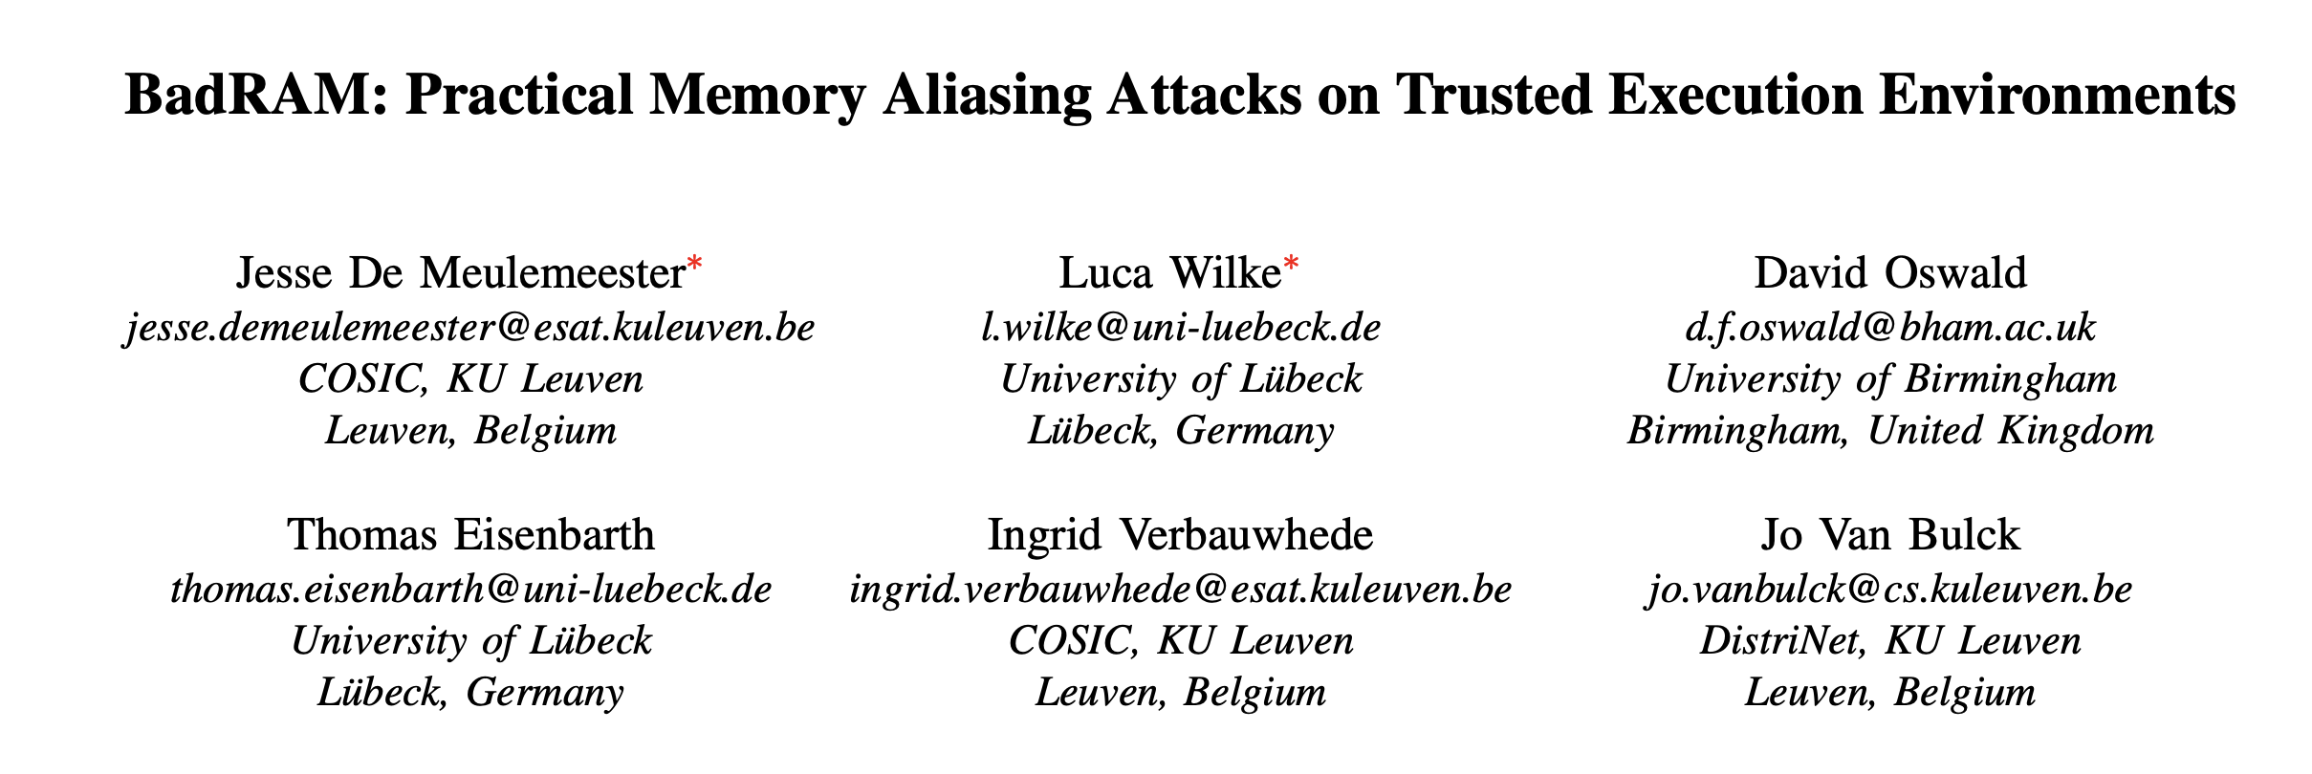
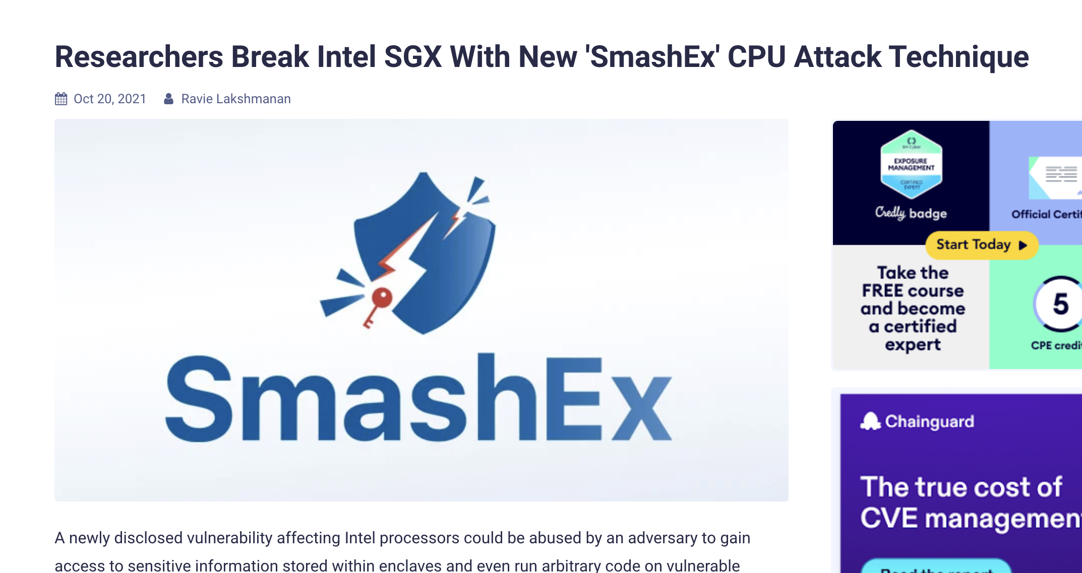
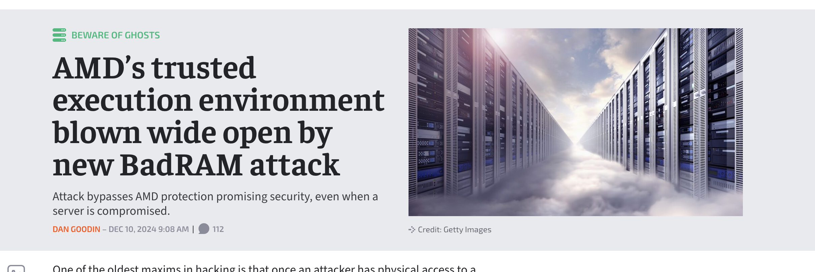
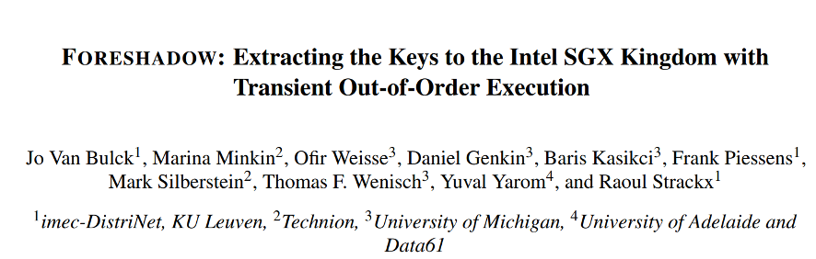
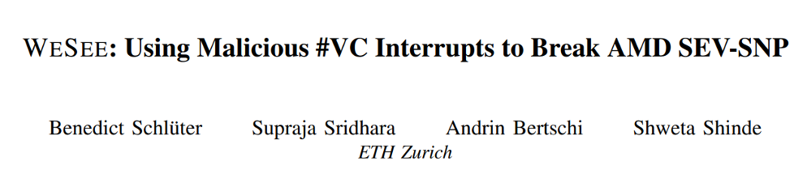
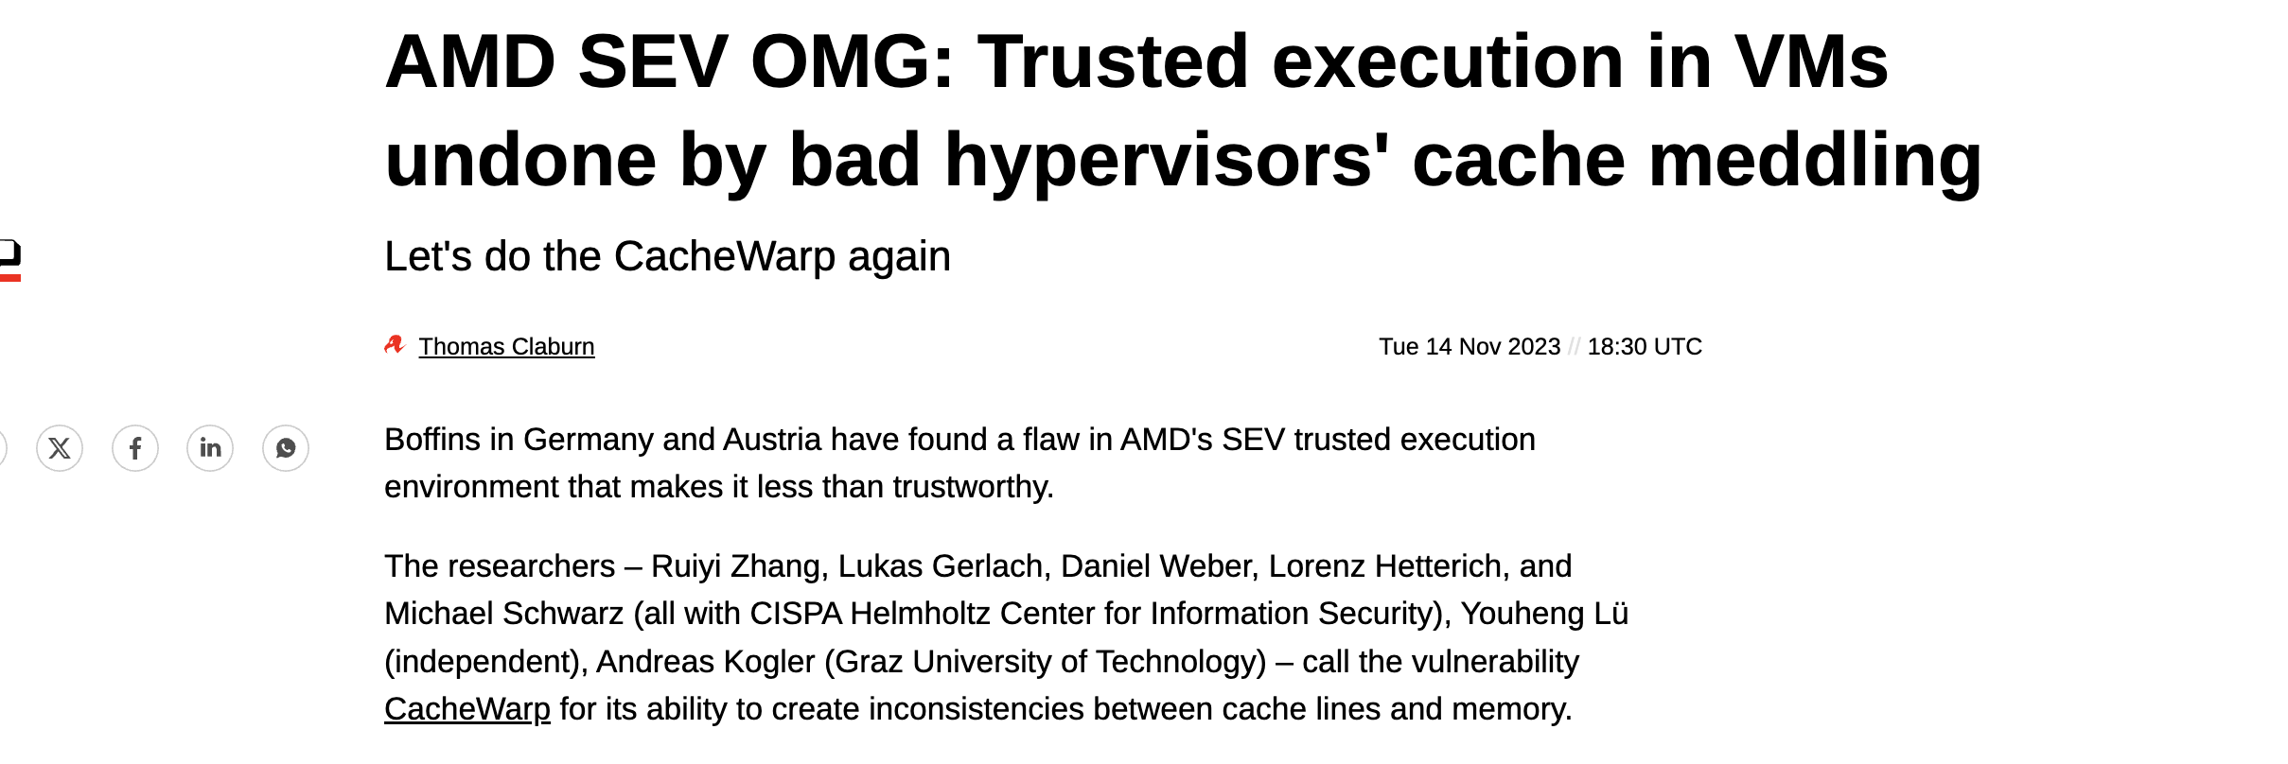
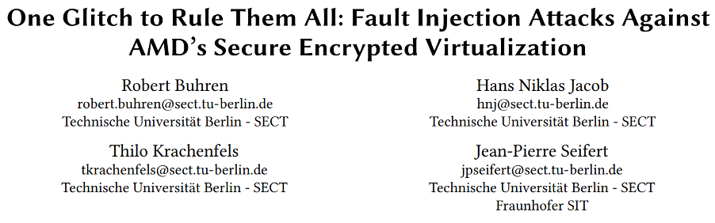
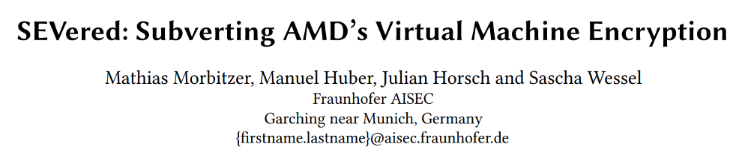

Slide 10
Impact Spectrum
Model Serving
Model Training
Analytics
Key Management

Slide 11
Impact Spectrum: Within an Application
Credit Score Update
High $$ Transfer
Low $$ Transfer
Account Deletion
Too optimistic: CFT
Too pessimistic: BFT

Slide 12
What do we need in a ledger?
①
Understands the reality of TEE compromises.
②
Offers flexible protection.
No ledger provides both 😔

Slide 13
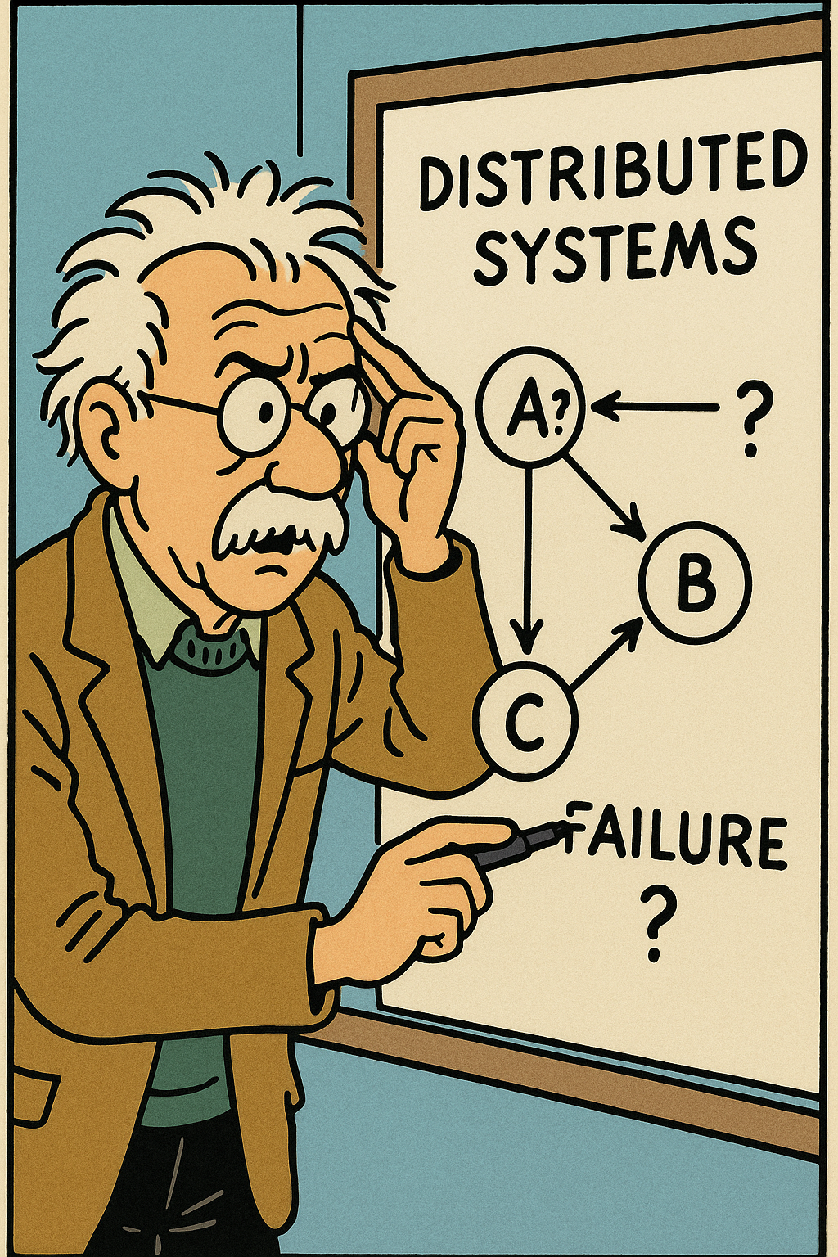
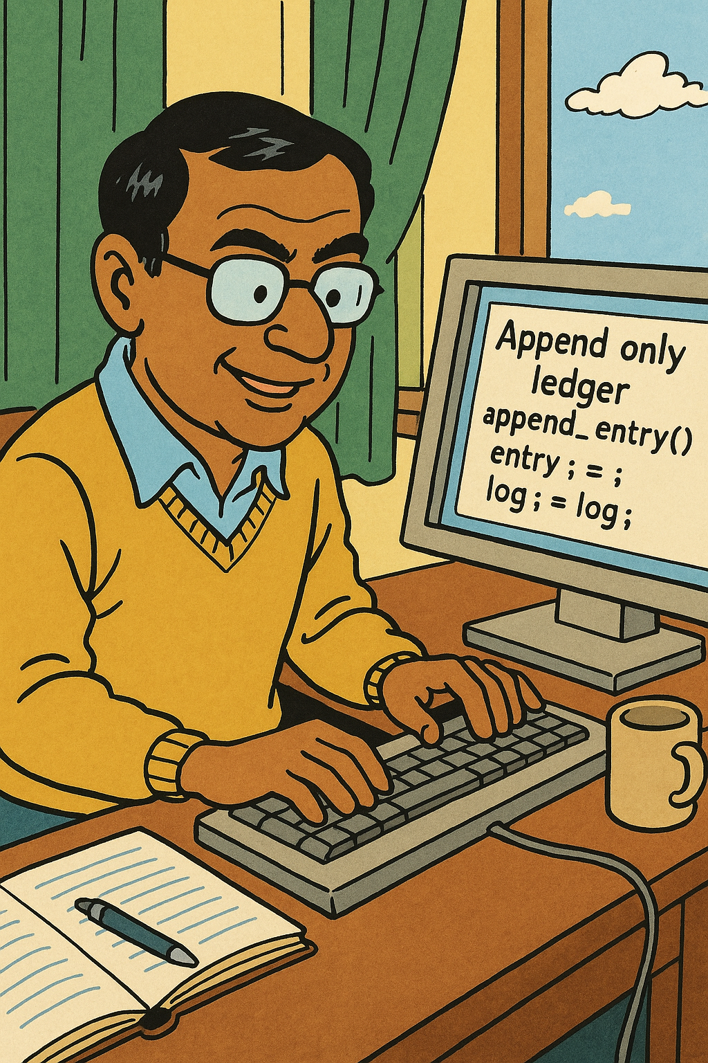
What can we do?
Correlated Failures
Rare TEE Compromises
Heterogenous Cluster
Auditing
Platform Fault Tolerance
PirateShip

Slide 14
What can we do?
Correlated Failures
Rare TEE Compromises
Heterogenous Cluster
Auditing
Platform Fault Tolerance
PirateShip

Slide 15
Platform Fault Tolerance (PFT)
Failures
Independent Crashes
Correlated Compromises
Platforms Capture Correlation

Slide 16

Platform is an Independent Failure Domain

Slide 17
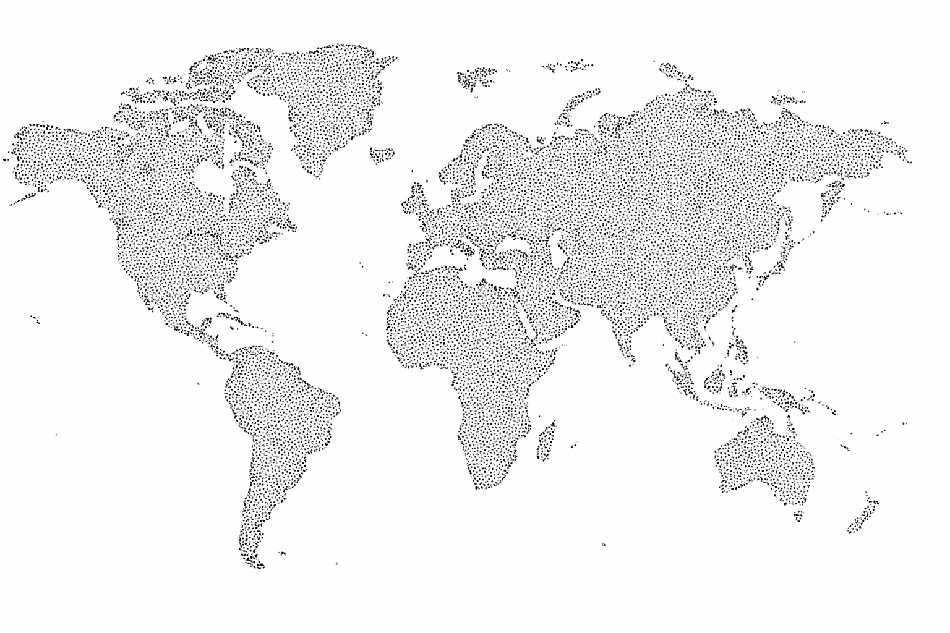
Platform is an Independent Failure Domain

Slide 18


Platform is an Independent Failure Domain

Slide 19
PFT Determines Safe Configurations
Safe up to 2 crashes + 1 platform compromise

Slide 20
PFT Determines Safe Configurations
Safe up to 1 crash + 1 platform compromise

Slide 21
PFT Determines Safe Configurations
Unsafe for 1 crash + 1 platform compromise

Slide 22
What can we do?
Correlated Failures
Rare TEE Compromises
Heterogenous Cluster
Auditing
Platform Fault Tolerance
PirateShip

Slide 23

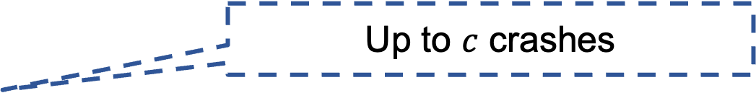
Dual notions of confirmation
Commit
Up to $c$ crashes
Audit
Up to $f_{p}$TEE platform failures

Slide 24
Dual notions of confirmation
Audit
Commit
Audited
Committed
Uncommitted
A
B
C
D
Audit/Commit
A
B
C
D
E
F
time
Audit
Commit
A
B
C
D
E
F
G
PirateShip lets YOU choose the max allowed gap

Slide 25
Dual notions of confirmation
PirateShip lets YOU decide when to execute
PirateShip lets YOU choose who pays the cost!
Audit
Commit
Audited
Committed
Uncommitted
A
B
C
D
E
F
G
Audit
Commit
A
B
C
D
E
F
time
On benign crashes
Audit / Commit
A
B
C
D
On rare TEE failures

Slide 26
Impact Spectrum
Credit Score Update
High $$ Transfer
Low $$ Transfer
Account Deletion
PirateShip lets YOU choose whether to pay the cost!

Slide 27
Let’s dive deeper!

Slide 28
Crash Fault Tolerance (CFT)
🍎
🍎
🍎
Client
🍎
🍎 is committed @ 100
🍎

Slide 29
Crash Fault Tolerance (CFT)
🍎
Client
🍎 is committed @ 100
29

Slide 30
Crash Fault Tolerance (CFT)
🍎
🍊
🍎
Client
🍐
🍎 is committed @ 100
🥑
30

Slide 31

Byzantine Fault Tolerance (BFT)
🍎 is committed @ 100
?
🍎
Client
🍎 is committed @ 100

Slide 32

Byzantine Fault Tolerance (BFT)
Client
QC
QC on QC
🍎
🍎
🍎

Slide 33
What if…
We ran CFT and BFT at the same time?

Slide 34
What if…
We embed BFT within the CFT protocol,
Without sending extra messages!

Slide 35
PirateShip
🍎
Enough to commit by CFT logic
🍎
🍊
🍎
🍊
🥑

Slide 36
PirateShip
Audit
🍎
Commit
🍎
🍊
🍎
🍊
🥑

Slide 37
PirateShip
🍎
🍊
🍎
🍊
🥑
🍊
Acts as
🍎

Slide 38
PirateShip
🍎
🍊
1️⃣
2️⃣
🍎
3️⃣
4️⃣
🍊
🥑
Everything up to 🍎 is audited

Slide 39
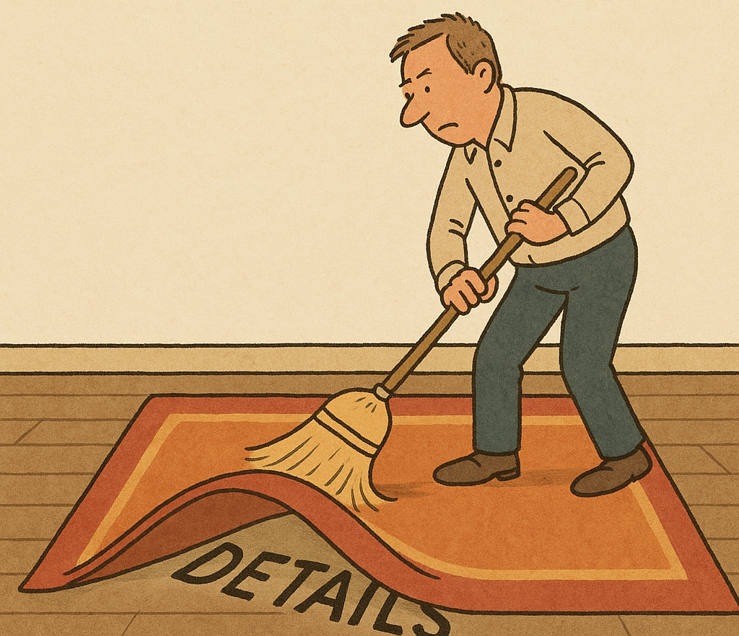

Summary
Byzantine Fault Tolerance
Audit Logic
Byzantine Fault Tolerance
Byzantine Fault Tolerance
Audit Logic
Audit Logic
Byzantine Fault Tolerance
Audit Logic
Crash Fault Tolerance
Current Ledgers

Slide 40
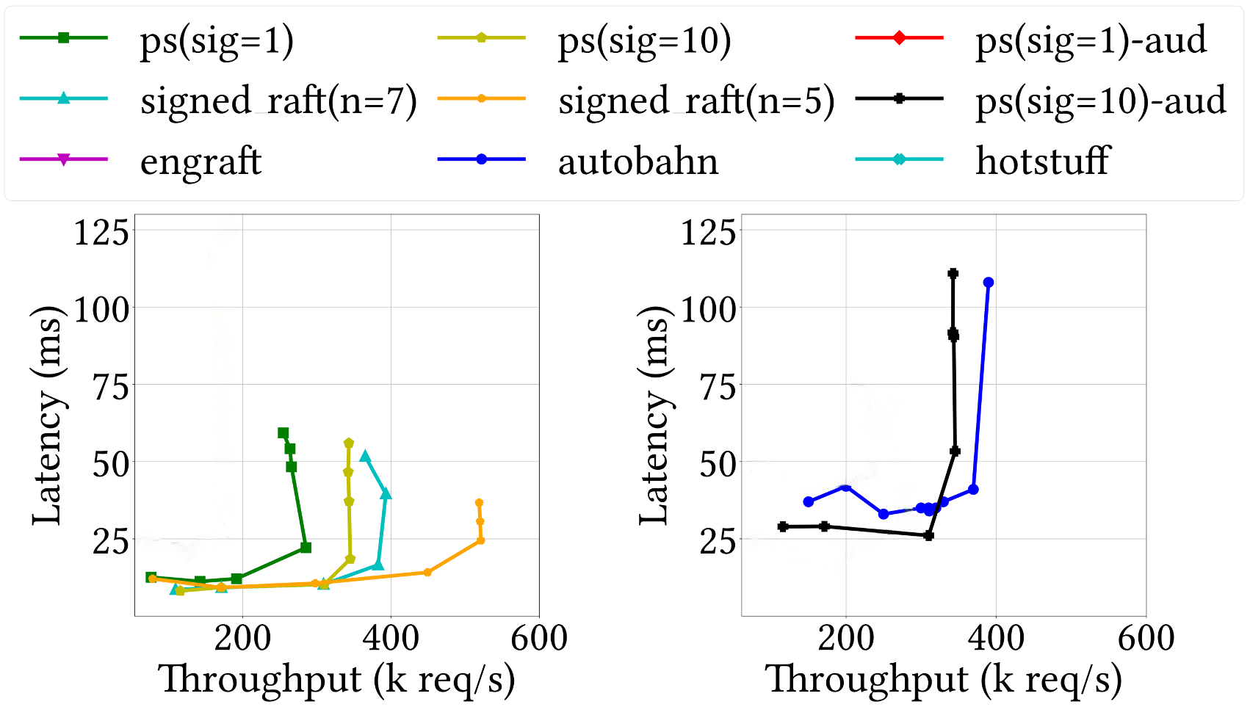
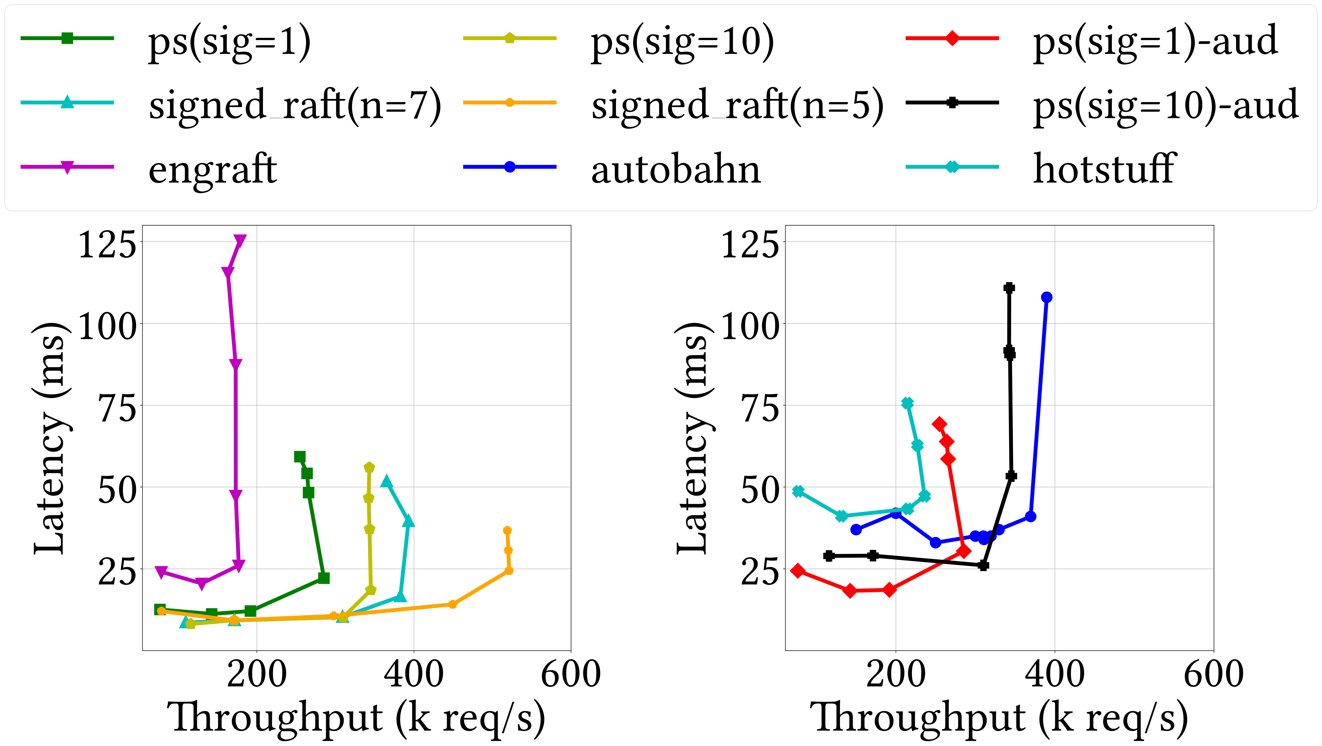
LAN Results
Notes:
Let's quickly look at some numbers.
This is a LAN setup with 7 nodes.
First, let's look at the commit performance.
When Pirateship signs every block, the leader is CPU bound.
However, just relaxing the signature interval to every 10 blocks, the leader becomes bottlenecked on its Network card's capacity.
It is made evident. by the fact that the performance is very similar to that of Raft (but with periodic signatures), and by the fact that, if we reduce the number of nodes from 7 to 5, the throughput increases roughly 1.5x.
<Click>
We compare against Autobahn, a SOTA BFT protocol. And turns out Pirateship provides lower latency than Autobahn, with slightly less throughput.
<Click>
Interestingly, both audit and commit have the same peak throughput.
<Click>
We also compared against host of other baselines and perform really well compared to them.
[Autobahn optimistic tips are turned off]

Slide 41
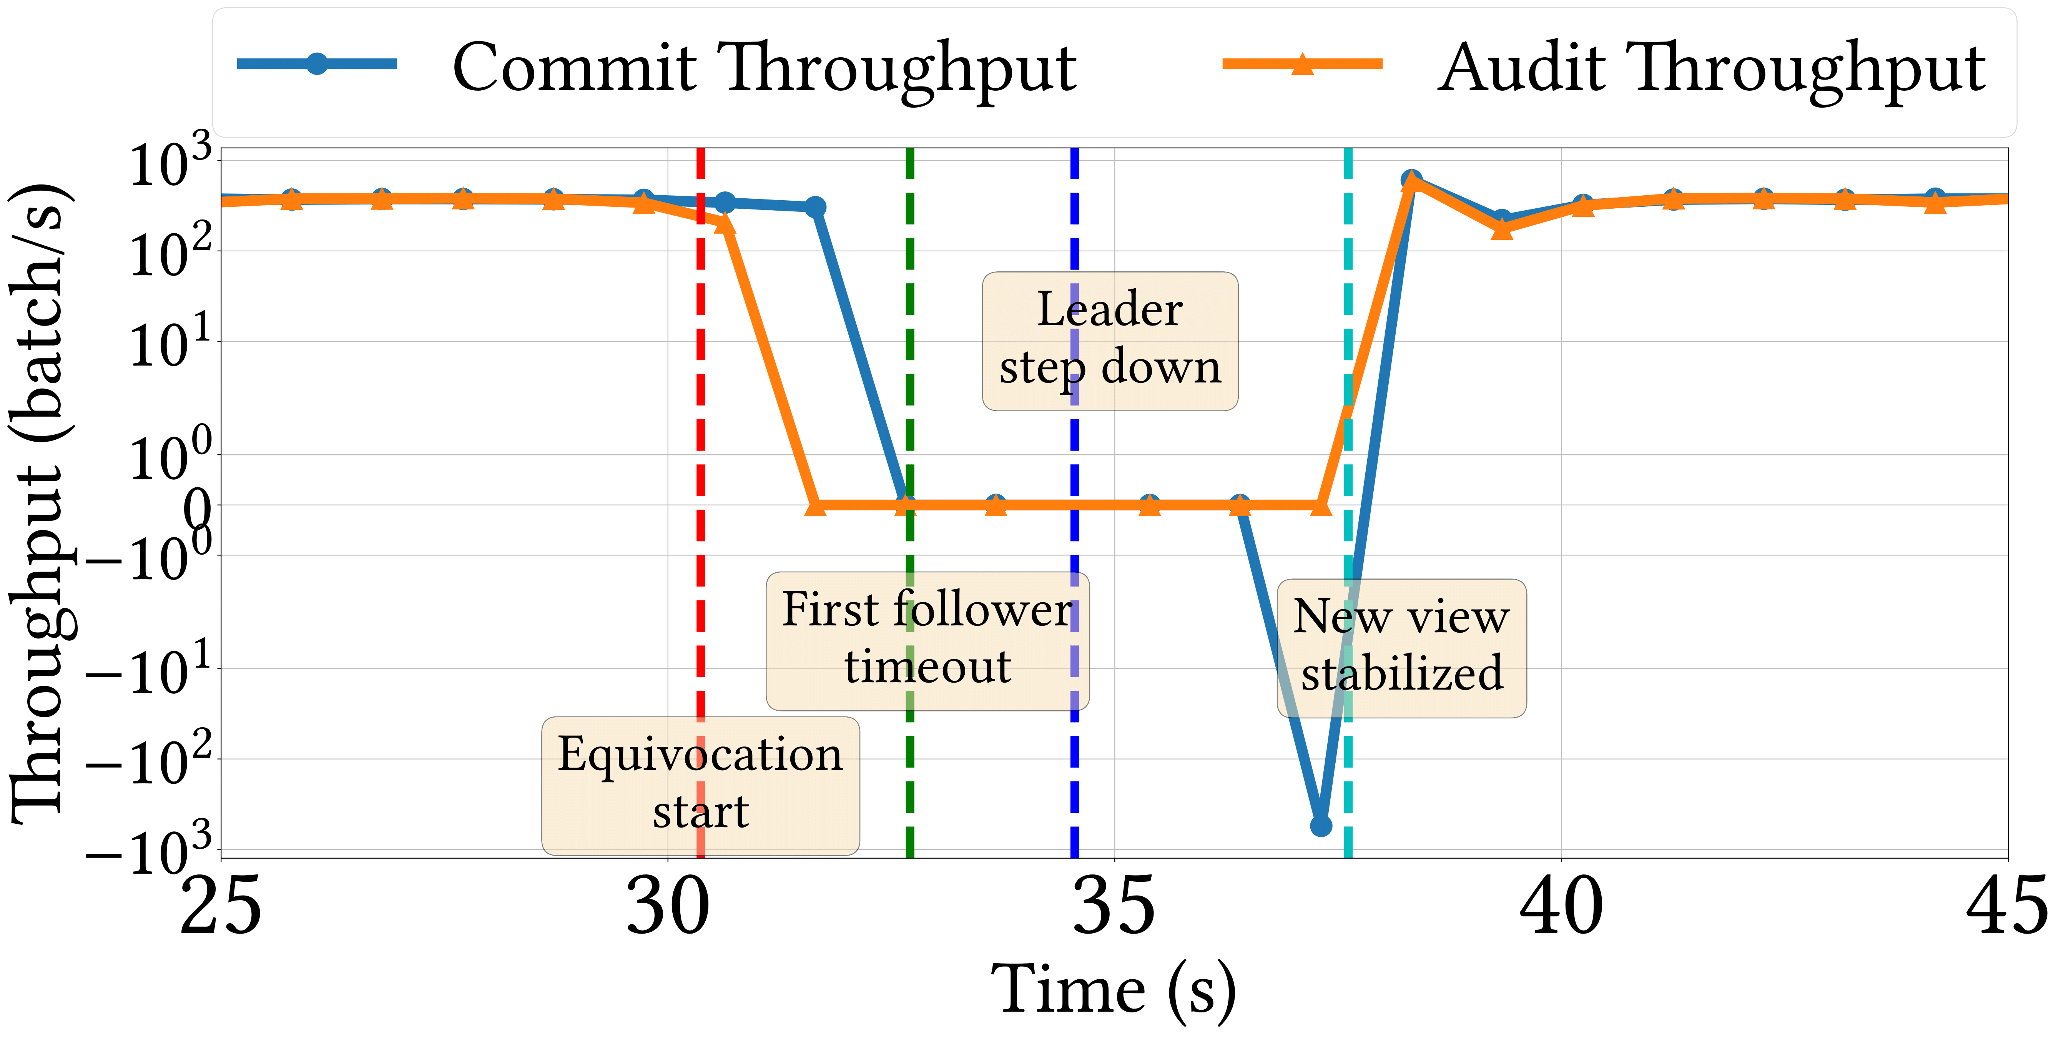
Recovery
Notes:
Let’s look at how Pirateship performs when the leader is equivocating.
<Click>
Initially, the leader behaves beningnly, and so commit and audit move at the same throughput.

Slide 42
Recovery
Notes:
Let’s look at how Pirateship performs when the leader is equivocating.
<Click>
Initially, the leader behaves beningnly, and so commit and audit move at the same throughput.

Slide 43
Recovery
Notes:
Let’s look at how Pirateship performs when the leader is equivocating.
<Click>
Initially, the leader behaves beningnly, and so commit and audit move at the same throughput.
<Click>
And then the leader starts equivocating to half the cluster, the audit throughput drops to 0 almost immediately, but the commit continues for some time.

Slide 44
Recovery
Notes:
Let’s look at how Pirateship performs when the leader is equivocating.
<Click>
Initially, the leader behaves beningnly, and so commit and audit move at the same throughput.
<Click>
And then the leader starts equivocating to half the cluster, the audit throughput drops to 0 almost immediately, but the commit continues for some time.
<Click> Then the followers keep timing out one after the other and call for a view change.

Slide 45
Recovery
Notes:
Let’s look at how Pirateship performs when the leader is equivocating.
<Click>
Initially, the leader behaves beningnly, and so commit and audit move at the same throughput.
<Click>
And then the leader starts equivocating to half the cluster, the audit throughput drops to 0 almost immediately, but the commit continues for some time.
<Click> Then the followers keep timing out one after the other and call for a view change.
<Click>
Once in a new view, some replicas need to rollback their state.

Slide 46
Recovery
Notes:
Let’s look at how Pirateship performs when the leader is equivocating.
<Click>
Initially, the leader behaves beningnly, and so commit and audit move at the same throughput.
<Click>
And then the leader starts equivocating to half the cluster, the audit throughput drops to 0 almost immediately, but the commit continues for some time.
<Click> Then the followers keep timing out one after the other and call for a view change.
<Click>
Once in a new view, some replicas need to rollback their state.
<Click> Thereafter, everything becomes smooth again.
Pirateship can detect correct equivocations within 10s of seconds.

Slide 47
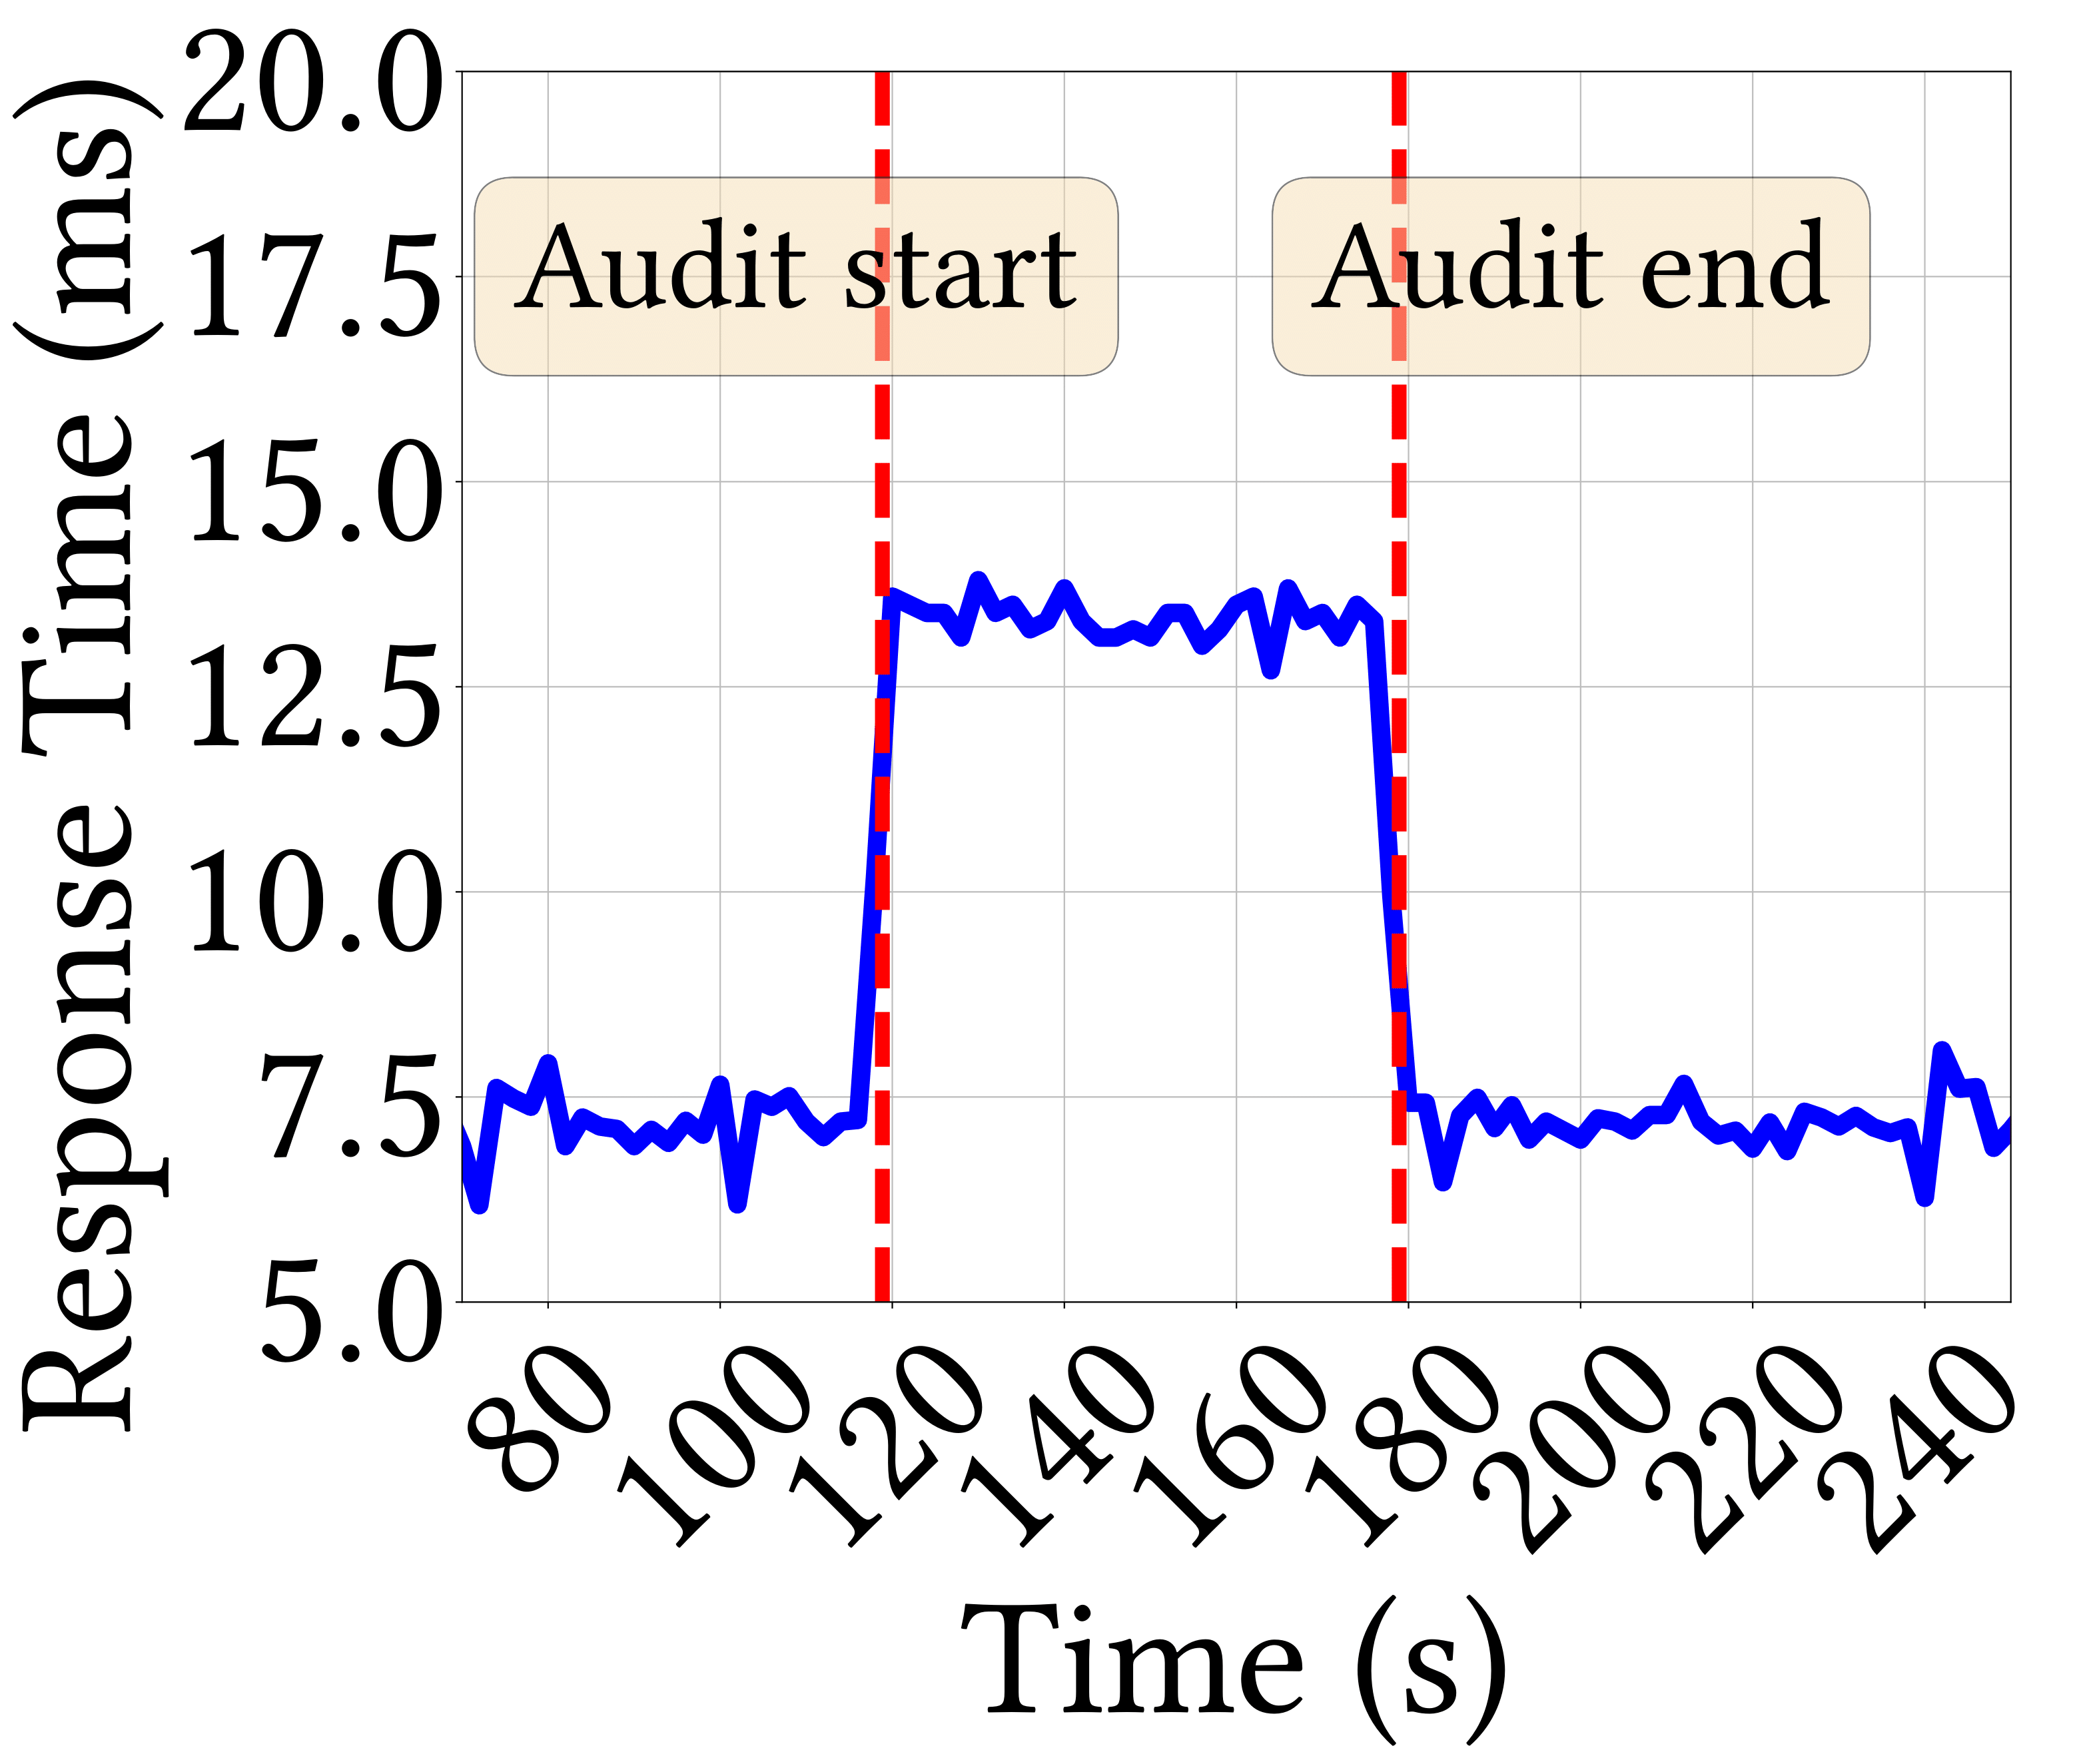
Response Time with Audits
Notes:
Lastly, we demonstrate how one can dynamically choose to pay the cost of auditing.
This simulates a situation where the sysadmin trust the tees and replies to transactions directly after commit.
But sometime down the line a vulnerability is discovered and fearing something may go wrong, the sysadmin just flips a switch and lets all transactions wait till audit.
This increases the average response time by almost 2x.
However, the threat is patched after some time, and the admin flips the switch back down and the latency almost immediately goes back to normal.

Slide 48
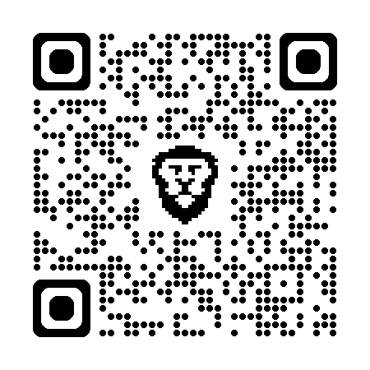
Conclusion
Questions?
shubham_mishra@berkeley.edu
Platform Fault Tolerance
Realistic model of TEE-based clusters
PirateShip
High performance PFT Ledger
Audit
Commit
A
B
C
D
E
F
G
Notes:
In conclusion, we present PFT a realistic model to view TEE-based clusters, and PirateShip, a high performance PFT consensus protocol.
Thank you!
<Remember, think before you answer>

Slide 49
Backup Slides

Slide 50
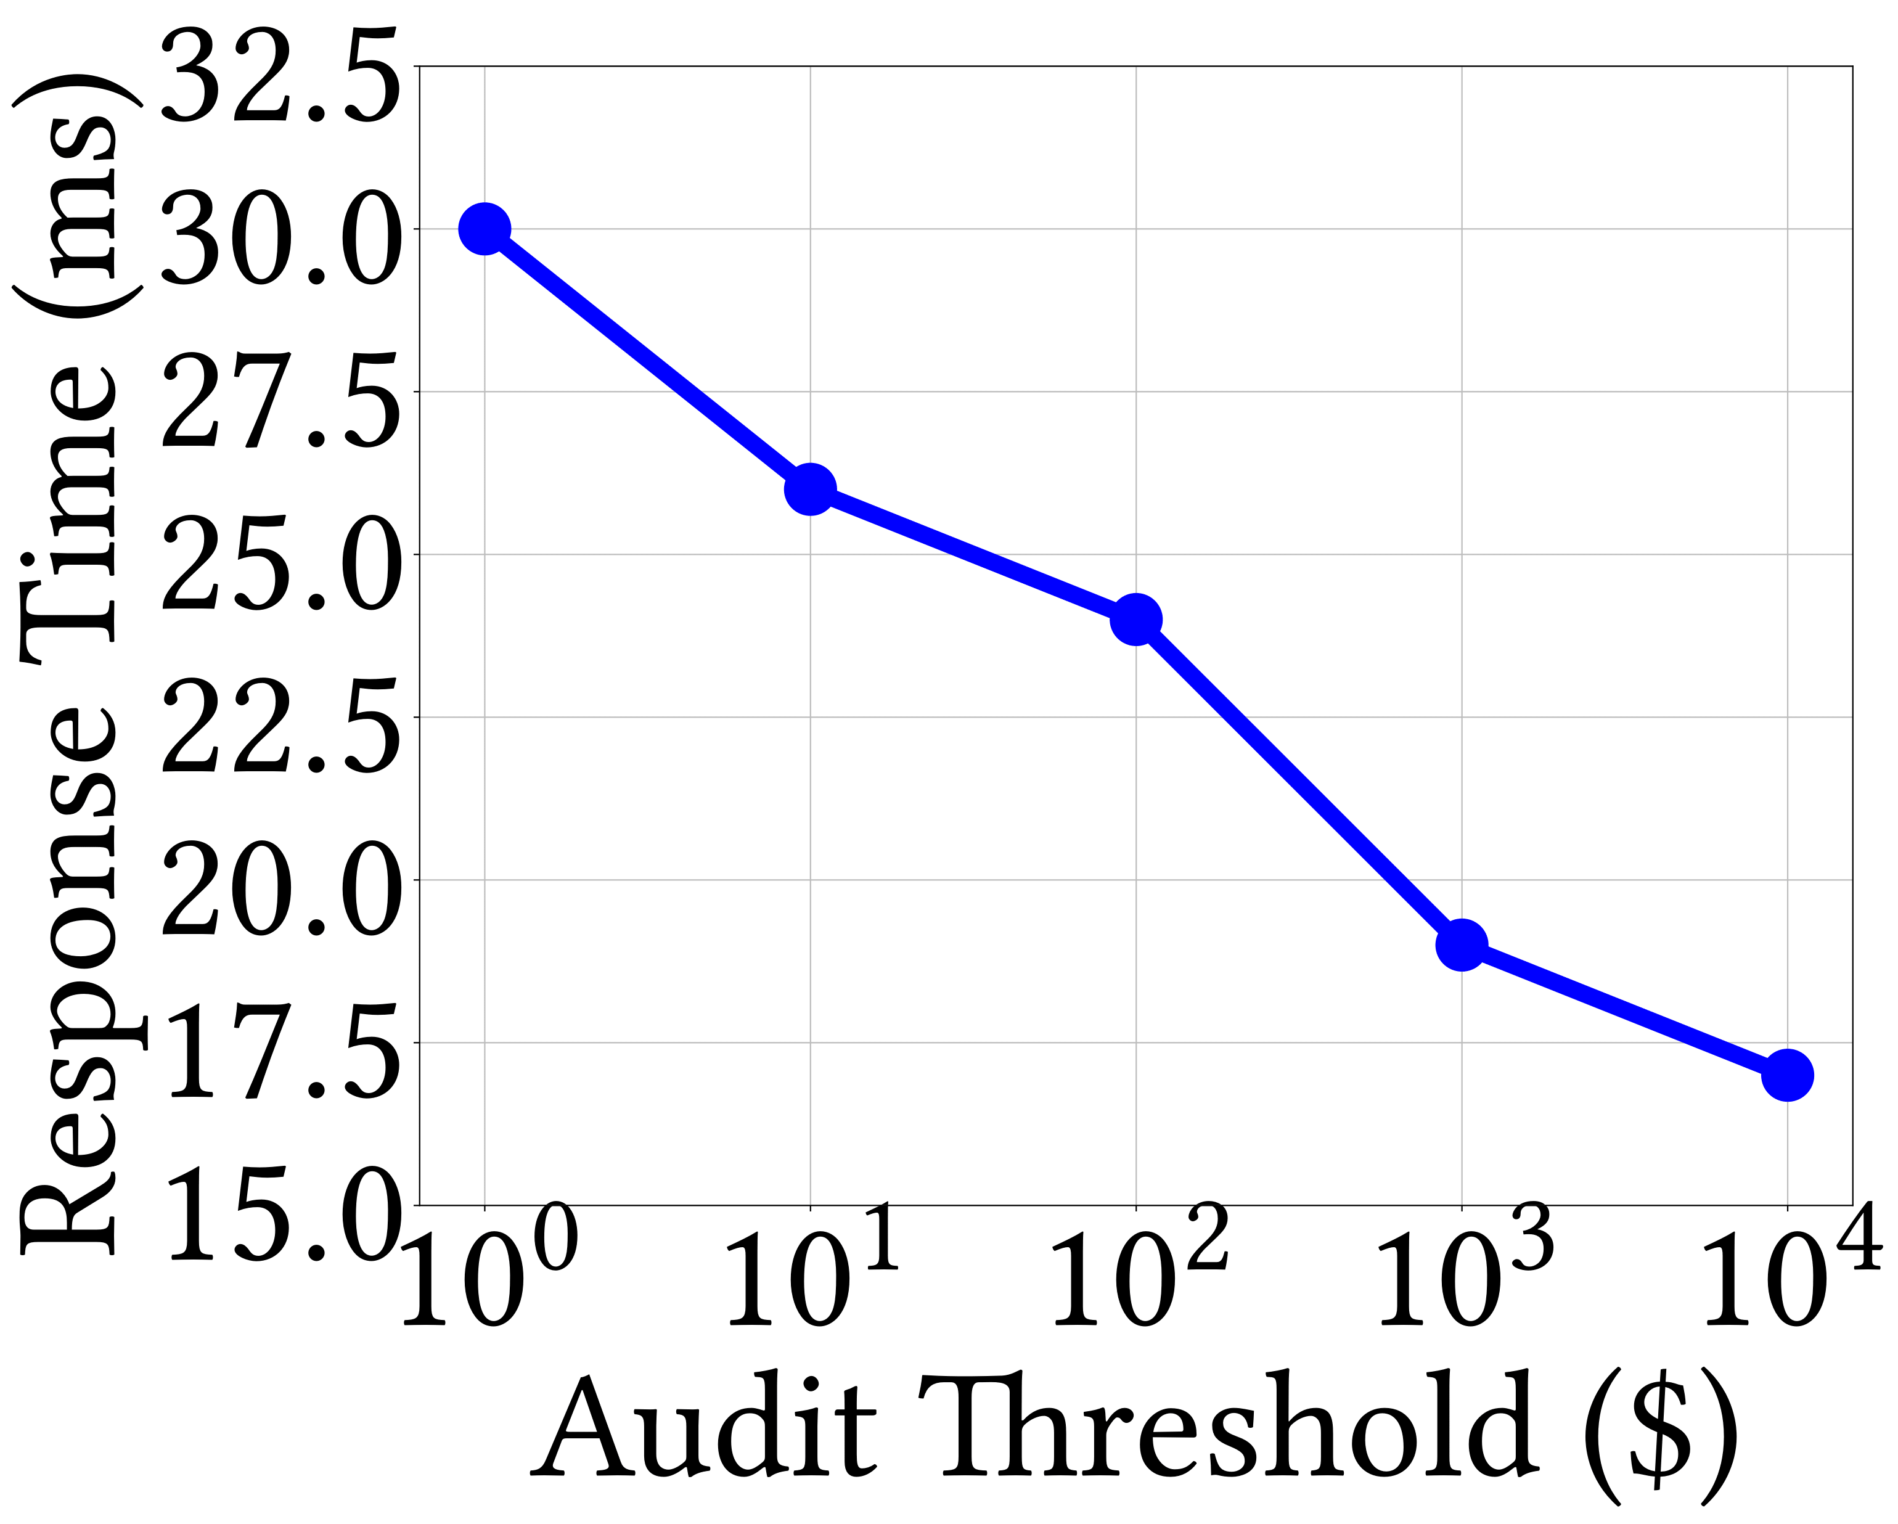
Monetary Threshold for Audit

Slide 51
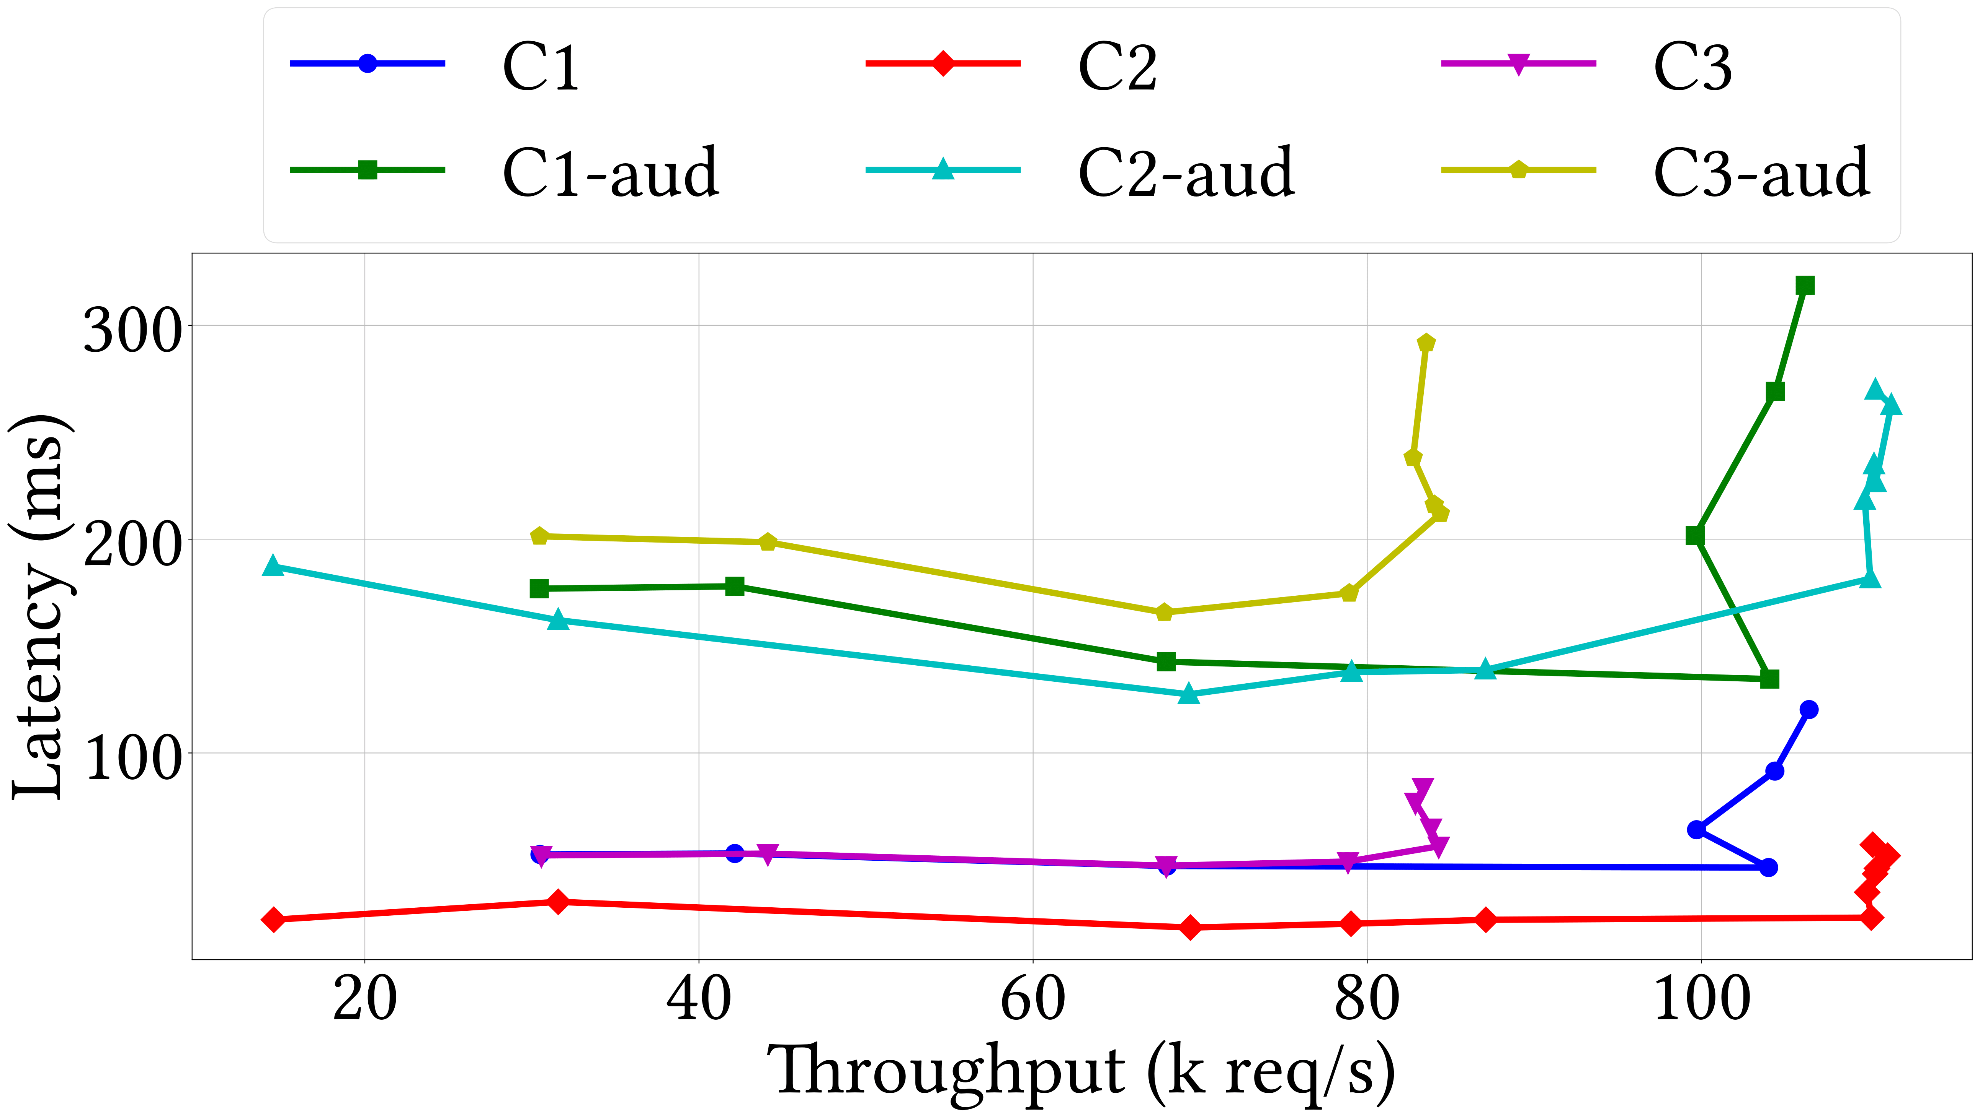
WAN Results

Slide 52
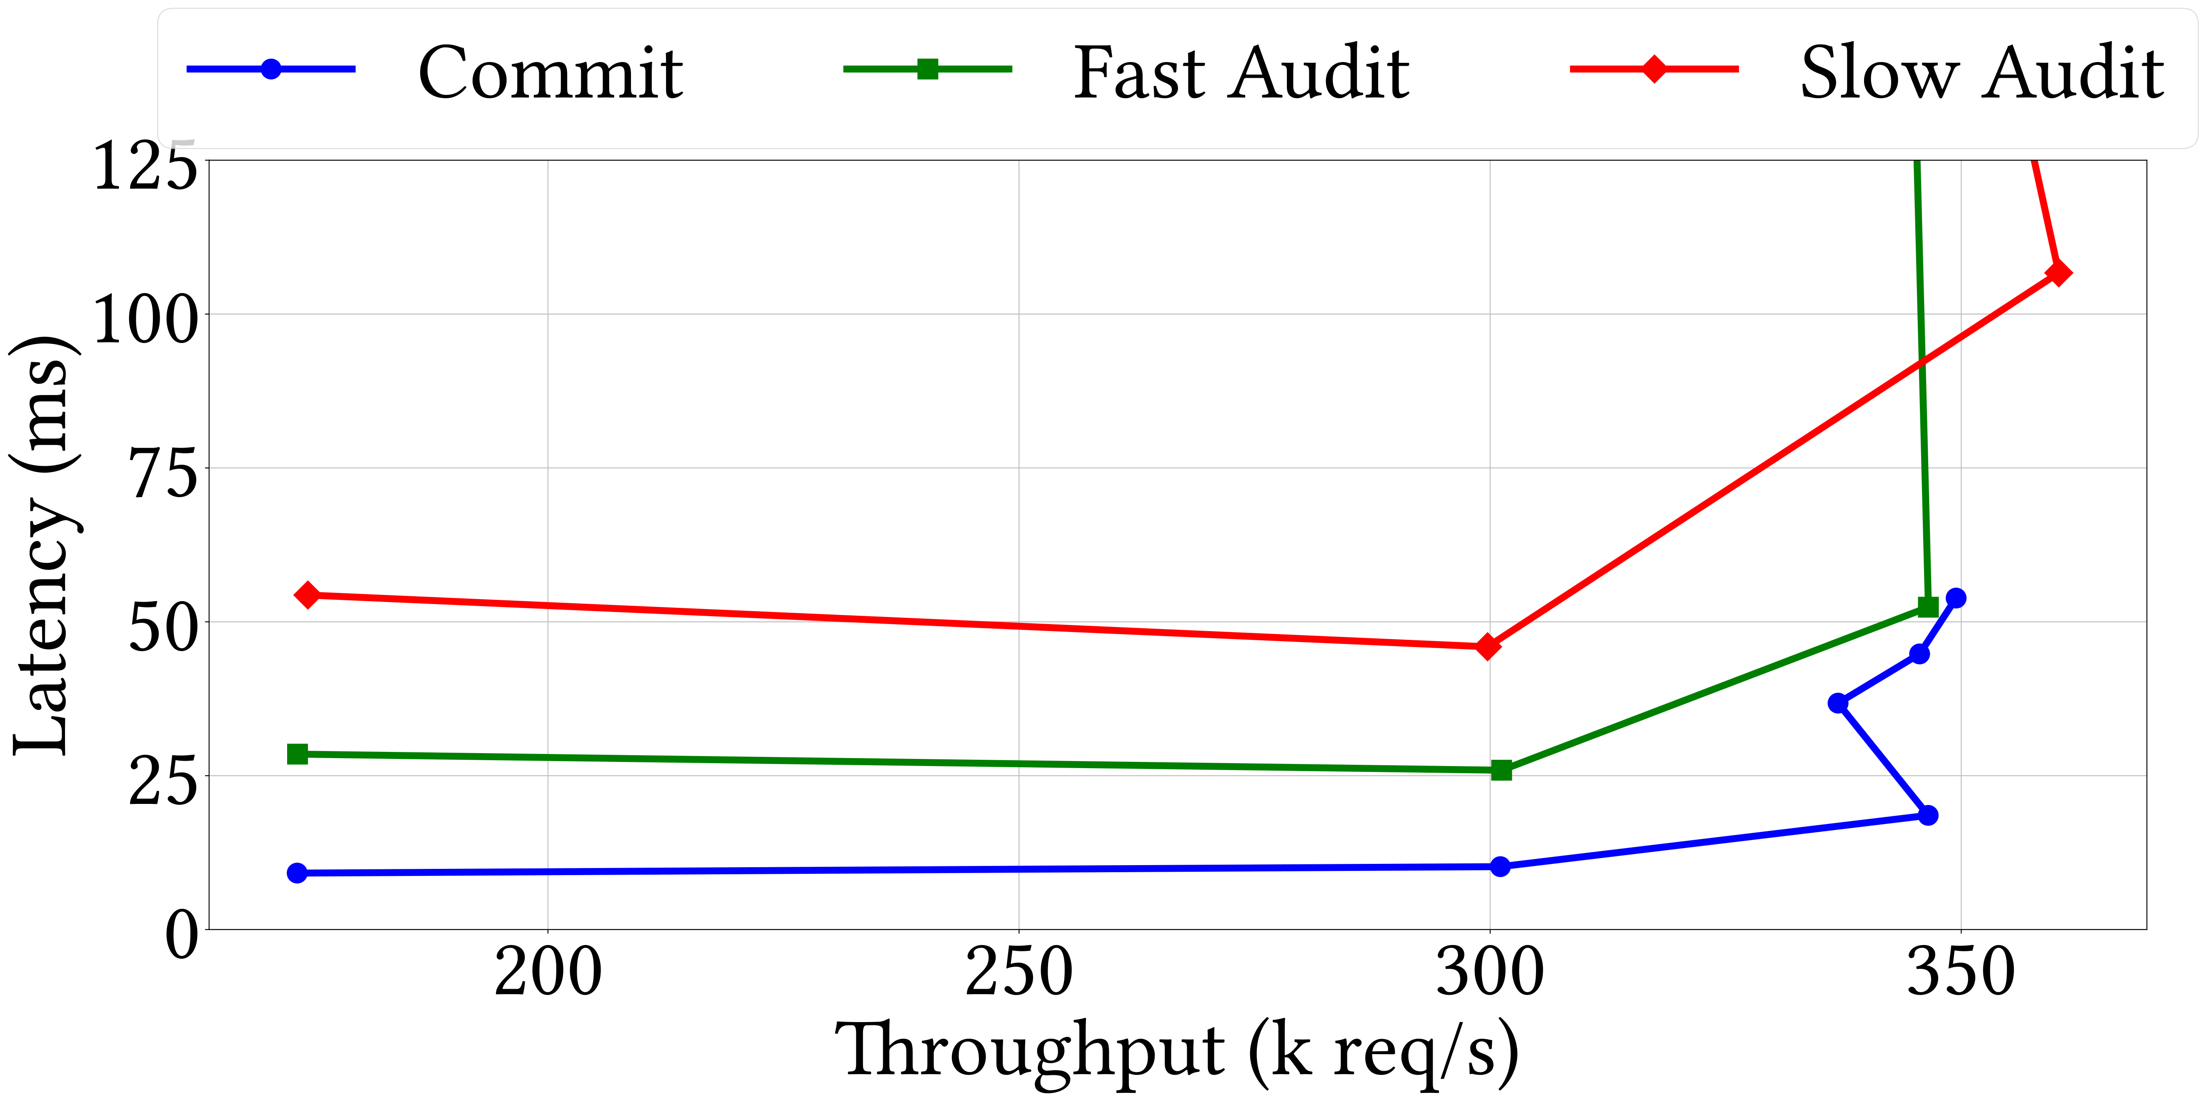
Fast vs Slow Path

